Slide 1

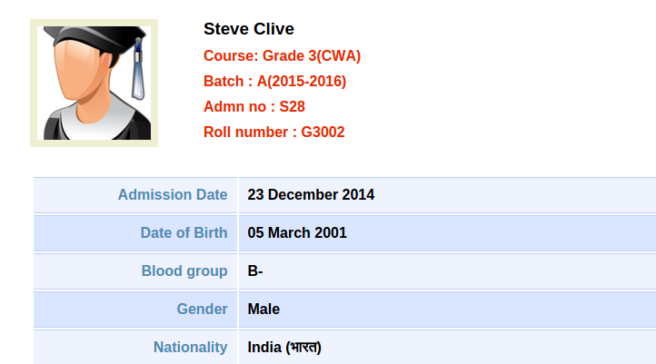



University Application Form Management System Using Spring Boot Microservices

Slide 2
Objective/Vision
A Web Application for University Admission Application where Student/Applicant can Register his detail/View/Modify his Profile.
Users Of Web Application
Only Student

Slide 3
Functional Requirements
Student:
Can Register
Sign in/View/Modify Profile
Log Out
Tools Used:
Eclipse
Apache Tomcat Server
Maven

Slide 4
Front End and Back End
Front End:
HTML
CSS
ThymeLeaf
Back End:
Spring MVC
Spring Boot
Hibernate

Slide 5
Technologies
Spring Boot
Spring Mvc
Hibernate
Maven
Microservices(ZuulProxy,Eureka,JUnit)

Slide 6
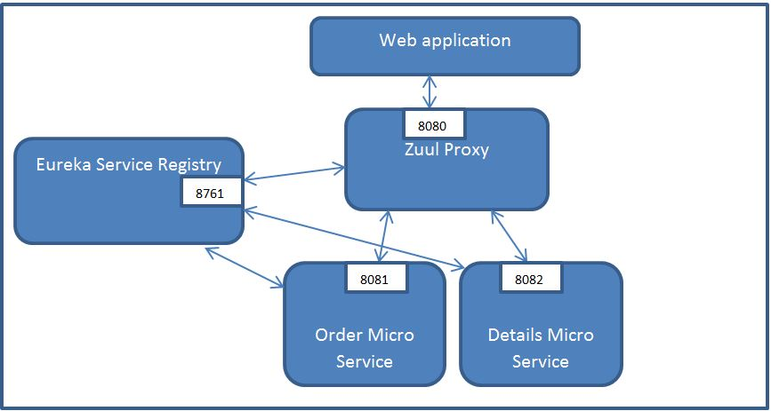
What is Microservices?
Microservices are an architectural style that develops a single application as a set of small services. Each service runs in its own process. The services communicate with clients, and often each other, using lightweight protocols, often over messaging or HTTP.

Slide 7
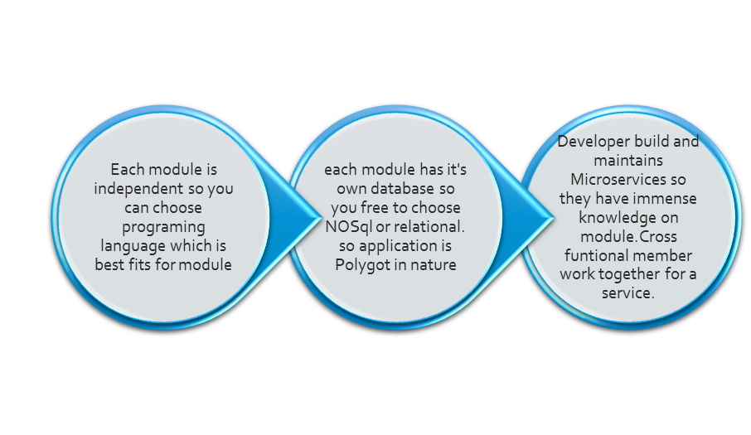
Why Microservices?

Slide 8
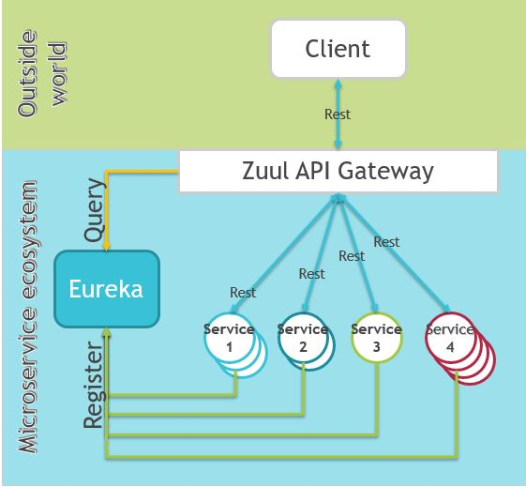
Work Flow OF Microservice

Slide 9
Zuul Proxy Server :
Zuul Server is a gateway application that handles all the requests and does the dynamic routing of microservice applications. The Zuul Server is also known as Edge Server.
Eureka Server :
Eureka Server is an application that holds the information about all client-service applications. Every Micro service will register into the Eureka server and Eureka server knows all the client applications running on each port and IP address. Eureka Server is also known as Discovery Server.

Slide 10
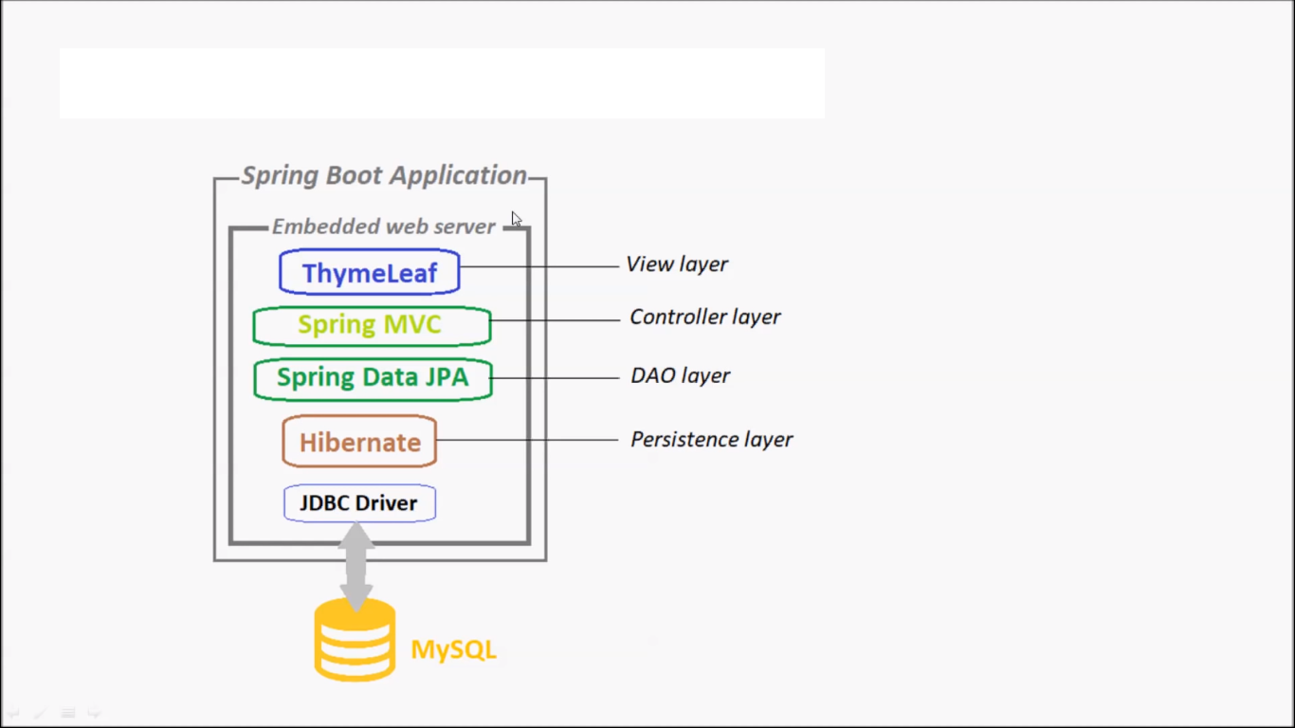
Layered Architecture Of Application

Slide 11
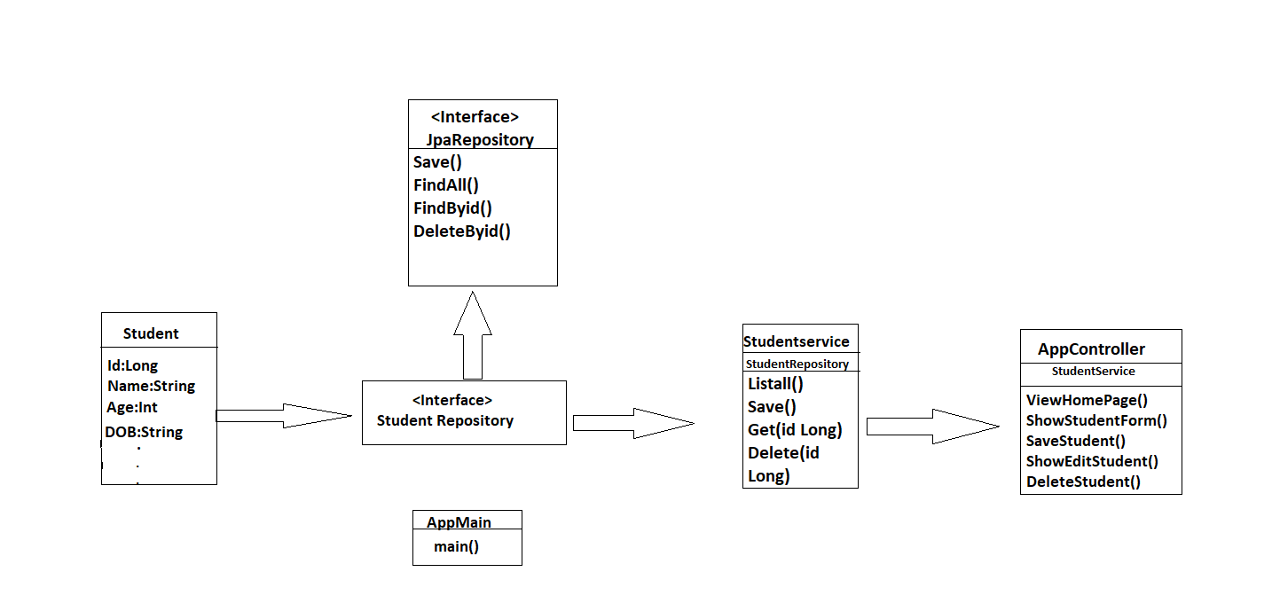
Work Flow Of Project

Slide 12
There are 4 services in our project
Student Registration
Student Sign in
View Profile
Student Record Modification

Slide 13
How Project Works?
Student will Put the URI In any Web Browser
University Registration Portal page will open
https:///C:/Users/JAURAV%20RATHORE/Desktop/Demo/login.html

Slide 14
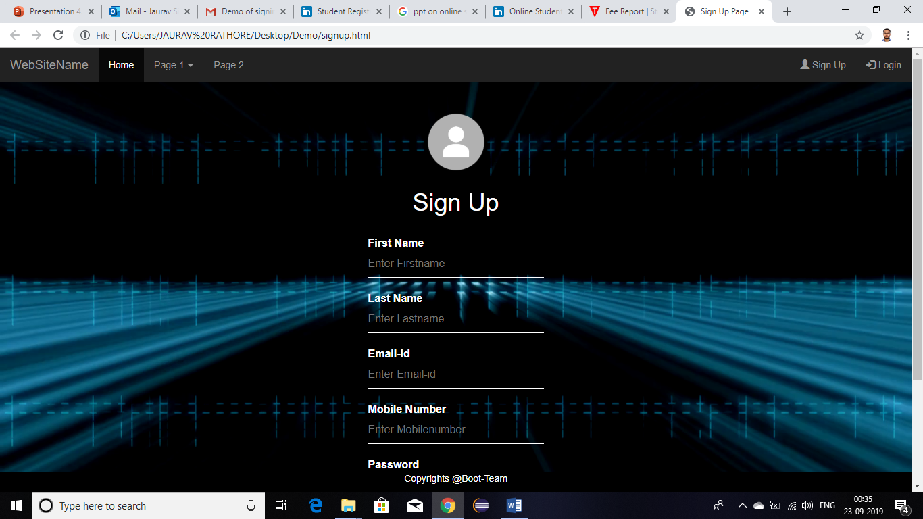
University Admission Portal Page

Slide 15
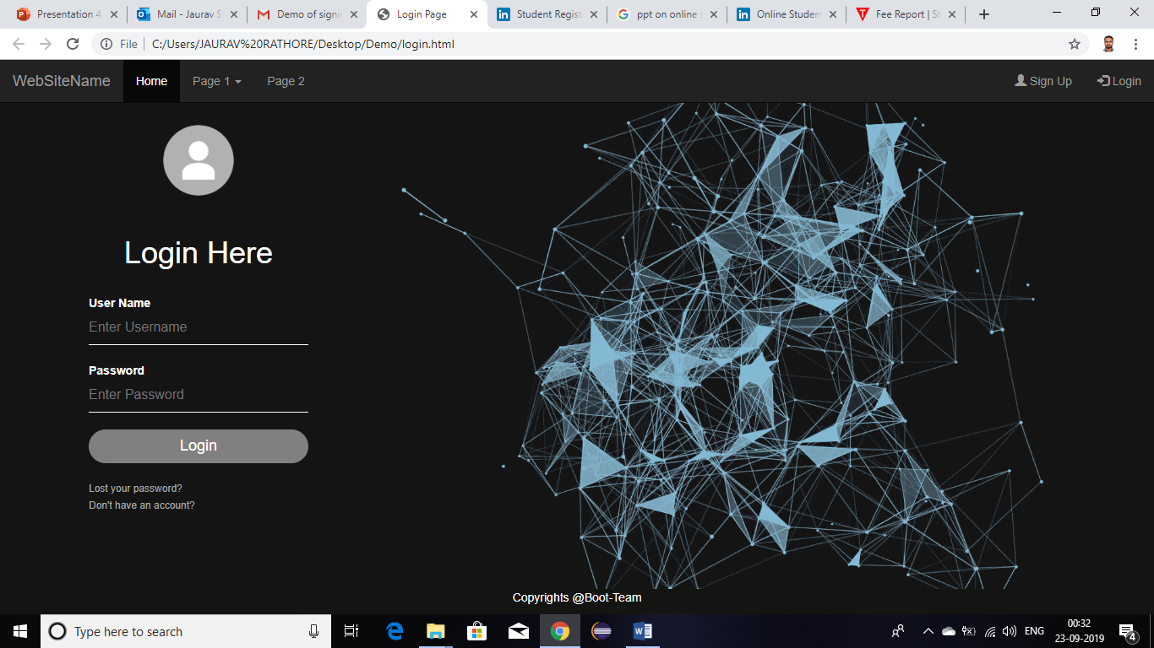
Click on Log in

Slide 16
How to Run This Project

Slide 17
Thank You

